Slide 1
Offline Handwritten Mathematical Expression Evaluator using Convolutional Neural Network
Amit Choudhary, Savita Ahlawat, Aniruddha Bhandari, Harsh Gupta,
Ankur Dhall, Manish Kumar

Slide 2
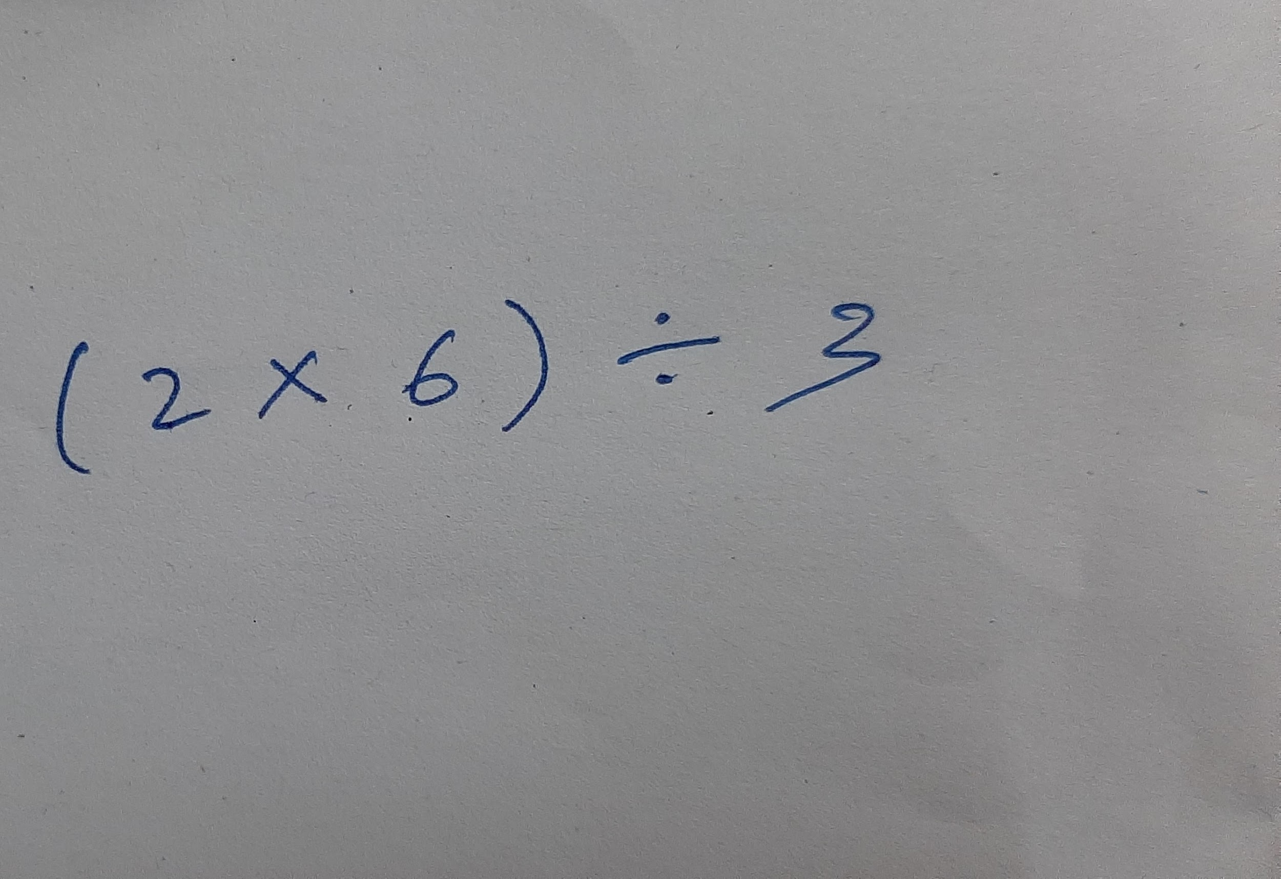
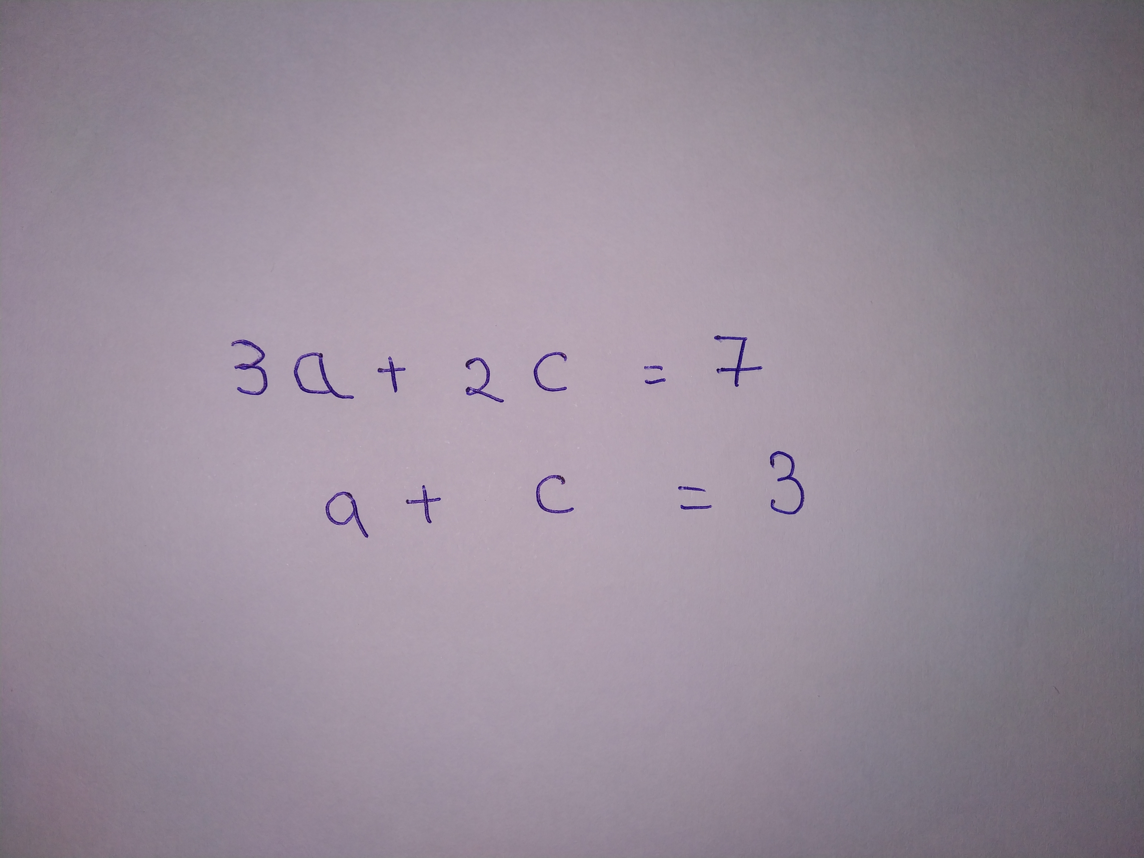
The Problem
Notes:
Typing sentences is much faster than writing by hand and the document lasts longer due to its digital format.
On the other hand, writing mathematical equations by hand is way more easier than typesetting them.
Whether you are taking notes in class, writing your paper which contains multiple equations, sharing your solutions for the weekly maths assignment with your friends, or if you are a teacher and are creating the maths assignment, it becomes way more easier for you and your peers if you have something to transform your ugly handwritten mathematical expression into a beautiful digital form so that the document can be easily stored, shared and understood by everyone.
Also, if you are someone you is not proficient with mathematics, someone who always gets confused with all the variables, it is always helpful to have some kind of a product to verify your mathematical solution.
This is what we have tried to achieve in this research paper by trying to digitize and evaluate simple handwritten arithmetic expressions and linear equations.
The user provides the image of the equation, which can include multiple equations, and our model tries to digitize and evaluate it.

Slide 3
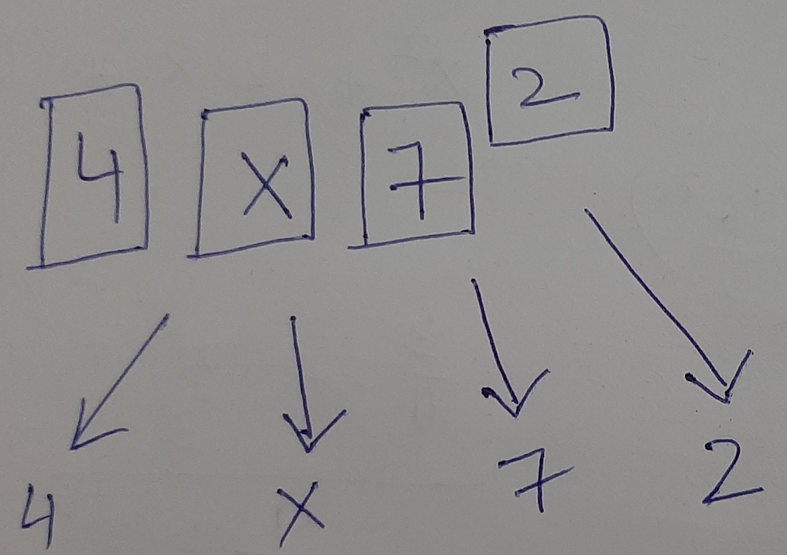
Solution
Preprocess & Segment input image to extract expression
Recognize handwritten expressions using Convolutional Neural Network (CNN)
Evaluating expression using custom-built parser
Notes:
Our approach to the problem can be broken down into three broad steps.
Preprocessing and segmenting the image to extract the expression variables, operators and operands
Recognizing the handwritten expression using CNN and by doing so, digitizing it
Solving the expression with our own algorithm and presenting the user with the output

Slide 4
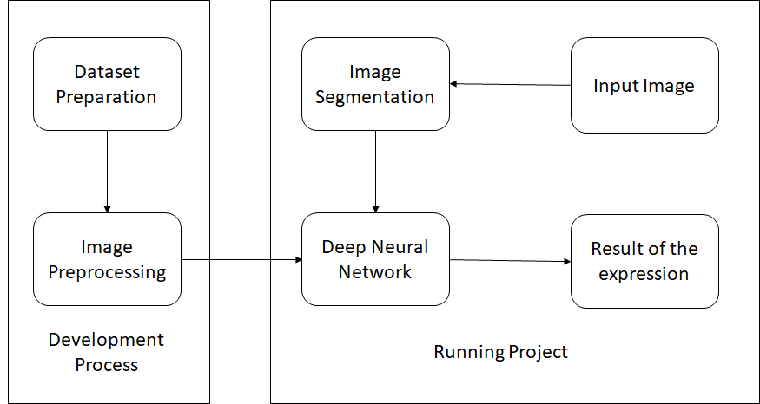
Model Development and Working
Notes:
This is a visual representation of how we developed our model and how the model finally works

Slide 5
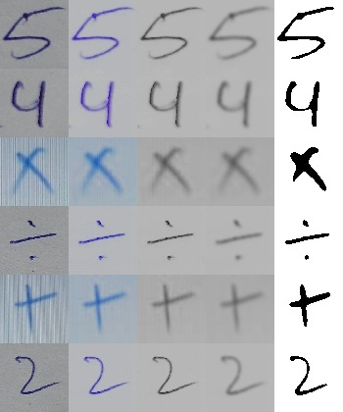
Preprocessing Input Images
BRIGHTNESS
(Value-185px)
GRAYSCALE
GAUSSIAN BLUR
(Kernel-7x7)
THRESHOLD
(Value-150px)
Notes:
Since we were using thresholding to segment the expression from the image, it was imperative to adjust it to a common value. However, this value was not suitable for every input image even after using Otsu threshold technique. Therefore, we decided to adjust the brightness of the image, right at the beginning, so that out segmentation technique works for any input image.
By converting coloured images into grayscale images reduces the processing power and time. Also, thresholding and edge detection algorithms work best with grayscale images.
Blurring reduces the amount of noise present in the image which helps during the processing of the image so that only relevant features will be extracted from the image.
Finally thresholding the resultant image to extract the expression from the background.

Slide 6
Input Brightness Grayscale Blurred Threshold
Image Image Image Image Image

Slide 7
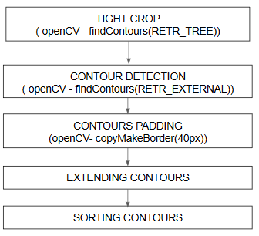
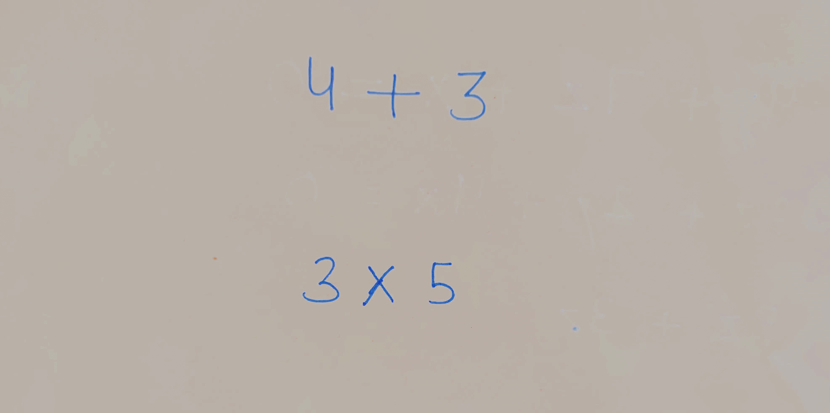
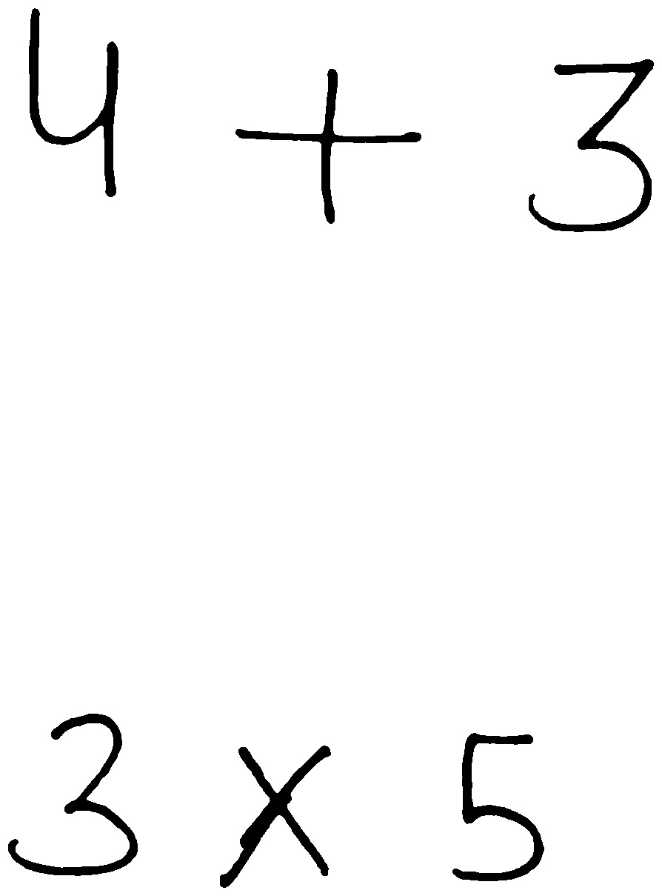

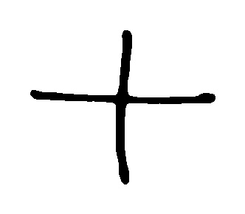
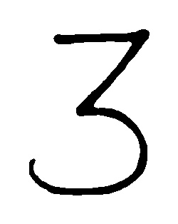


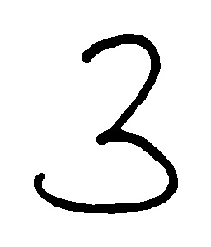







Segmenting Preprocessed Images
Notes:
Tight crop - to remove small and meaningless contours from as they can be marks on paper/noise.
Used opencv findcontour(), RETR_TREE hierarchy of contours to detect all contours. Then remove those with area<0.2% of total image area. 0.2% is experimental value. This way remove those small contours that would have otherwise reduced the accuracy of the model. Resultant image tightly cropped between min and max x and y values.
Contour detection - using findcontour() RETR_EXTERNAL hierarchy of contours to get the outer contours containing the complete digit. This again filters out the small contours that are part of digits/operators. EX- including upper line on 5, inner circle in 6
Extending the contours in case of ‘=’ and ‘/’ because opencv would detect them as separate units.
Finally sorting all the contours according to the original arrangement as in the image.

Slide 8
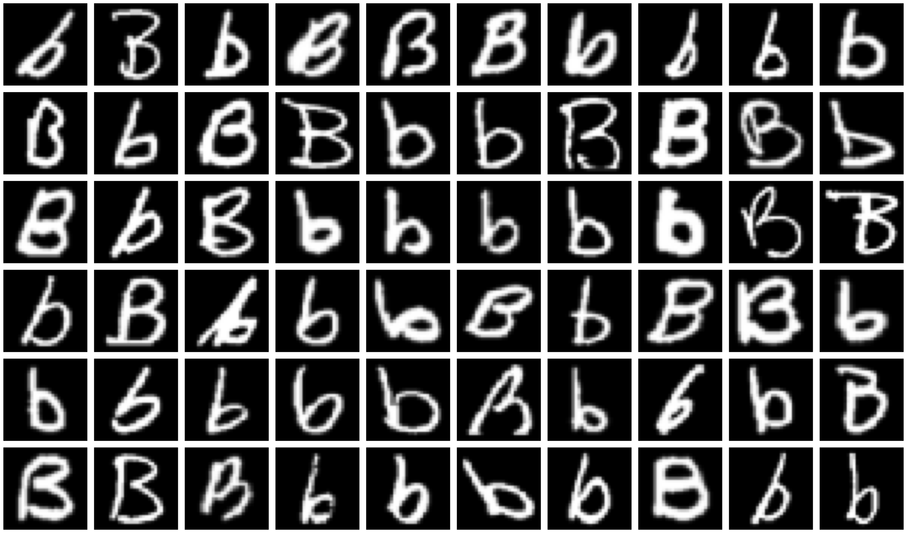
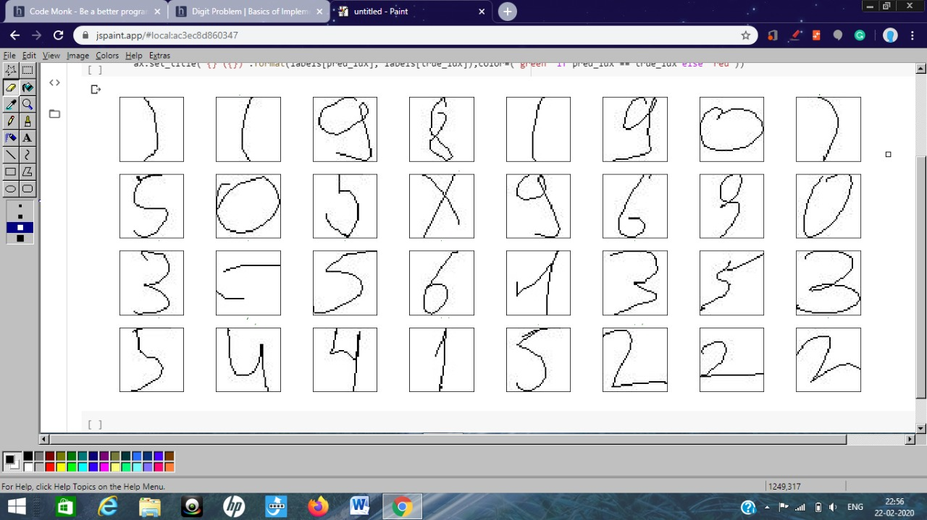

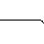
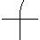
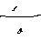
Dataset
EMNIST dataset and “Handwritten math symbols dataset” from Kaggle
(0-9), (a,b,c,d,u,v,w,x,y,z), (+,-,*,’(‘,’)’ ,÷) totalling 26 input characters and 2471 images for each character

Slide 9
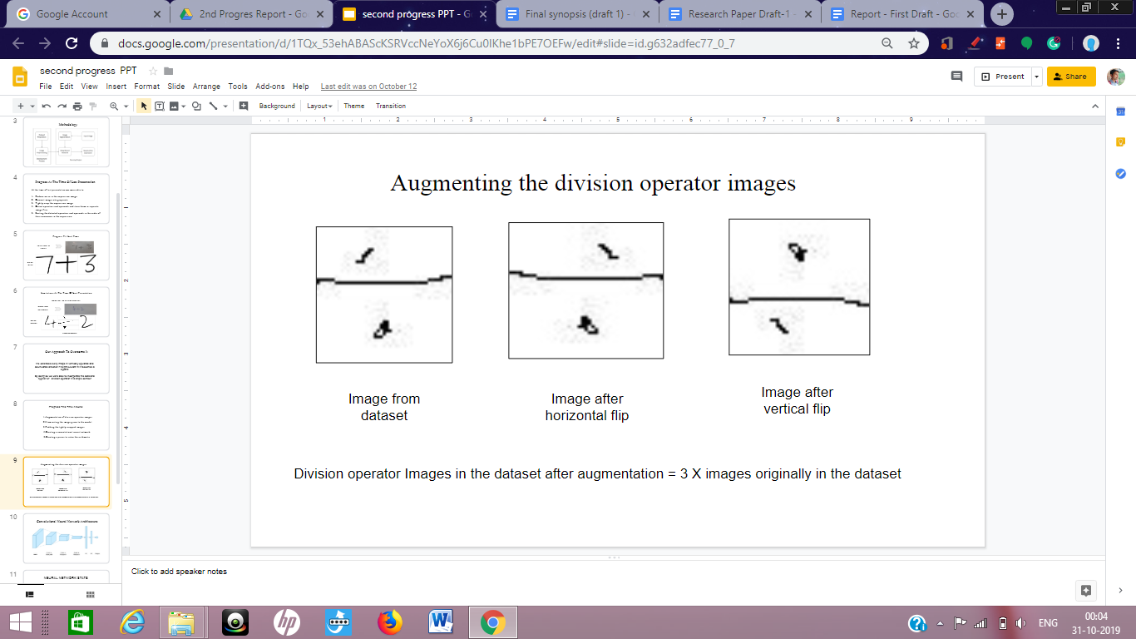
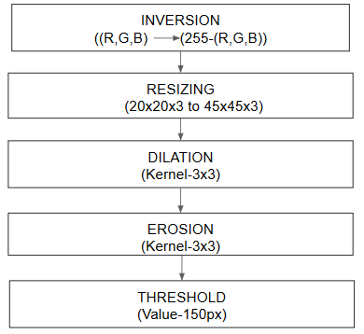


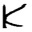

Problems with dataset
Fewer images for division operator
Images had characters with thin strokes that are partially visible
Parenthesis looked like ‘1’
Notes:
Augmented division operator with horizontal and vertical flips: ~700 before ->2471 after
Augmented character images - dilation to remove noise, erosion to increase the foreground
Included top and bottom padding 14 px in parenthesis to make them bulge in the center

Slide 10
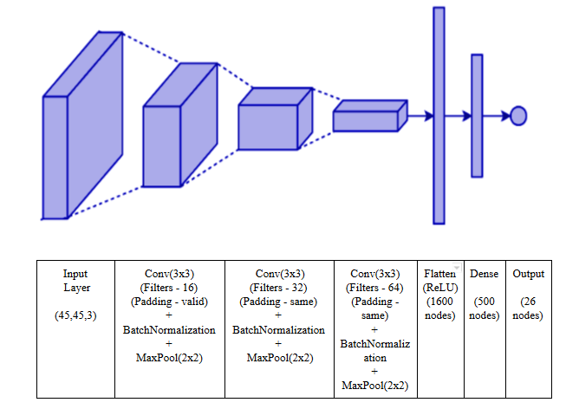
Recognizing Characters using CNN
Notes:
CNN with 3 conv layers , including batch norm and max pooling.
Flatten with ReLU activation function and Dense layer
CNN trained on 61149 images : 26 classes, 2471 images for each class

Slide 11
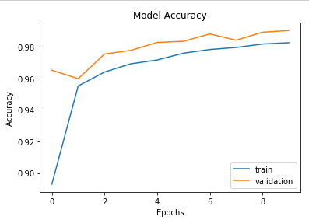
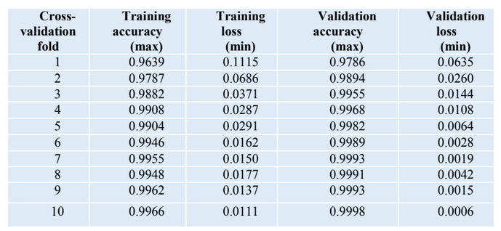
CNN Result
CNN got an accuracy of around ~99% with 10-fold cross-validation to
overcome overfitting.
Notes:
Improving training and testing accuracy with 10 fold cross validation
Decreasing validation loss

Slide 12
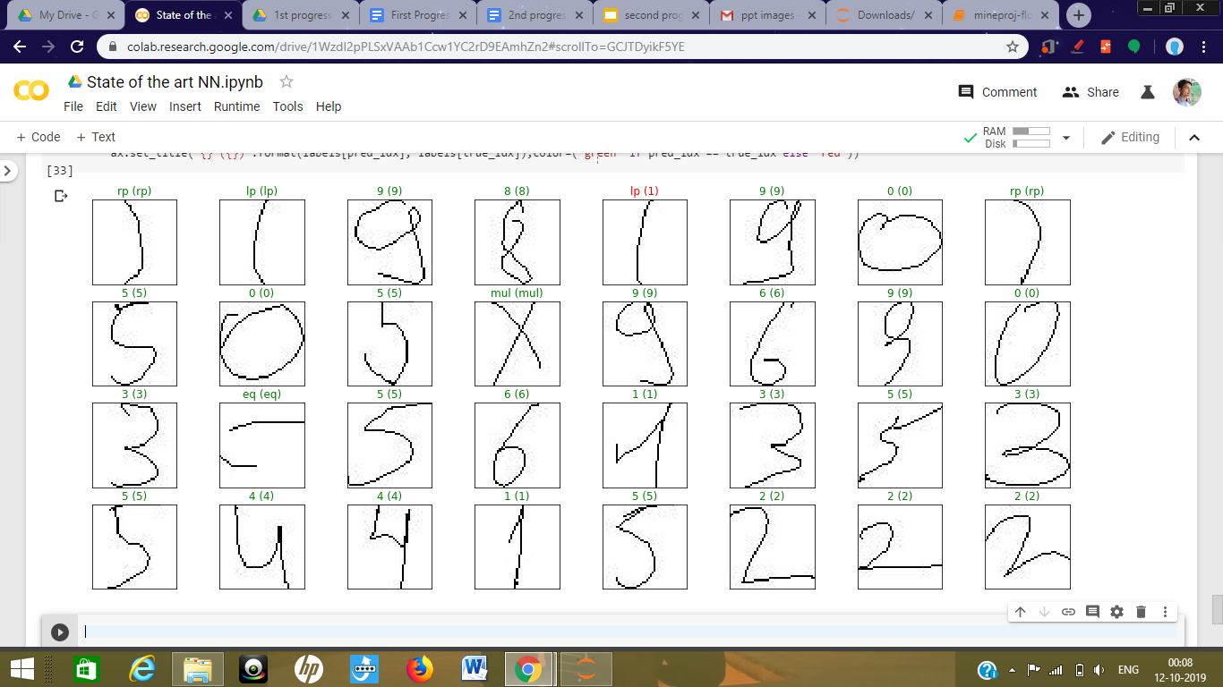
CNN prediction on some random images from dataset

Slide 13
Evaluating Mathematical Expressions
TOKENIZING CHARACTER STREAM
DETERMINE PROBLEM TYPE
IDENTIFYING INDIVIDUAL LINEAR EQUATIONS
CONVERT EXPRESSION INTO POSTFIX
EXTRACTING COEFFICIENTS FROM EQUATIONS
EVALUATE THE POSTFIX EXPRESSION
SOLVING EQUATIONS USING NUMPY LINEAR ALGORITHM SOLVER FUNCTION
Notes:
Check correctness - whether linear equation solvable or not
Identifying individual linear equations
Extracting coefficients from equations
Solving the equations using numpy linear algorithm solver function
Np.linalg.solve()

Slide 14
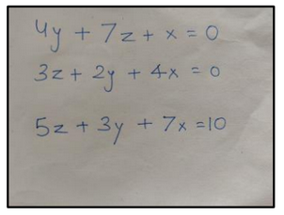
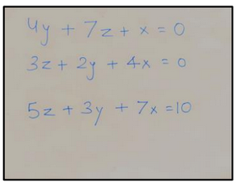
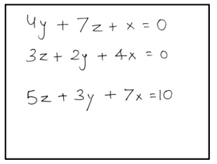
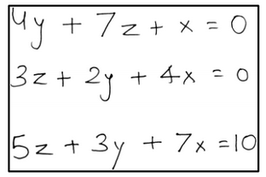
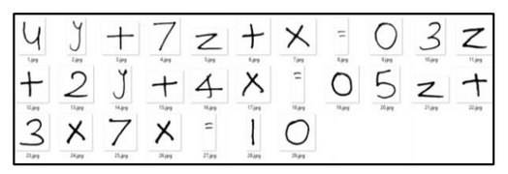
Notes:
Original -> brightness controlled->preprocessed ->tightly cropped->segmented images

Slide 15
Summary
Only arithmetic and linear mathematical expressions were considered in this paper.
A pre-contour filtration technique was suggested to remove distortions from segmented symbols which was able to reduce the noise from images to a great extent.
The sorting technique designed was able to preserve the equation order for any number of expressions in the image.
The customized convolutional neural network designed gave a convincing result with an accuracy of 99% in recognizing the segmented symbols.
Finally, the correct evaluation was achieved for the tested expressions using custom built parser.

Slide 16

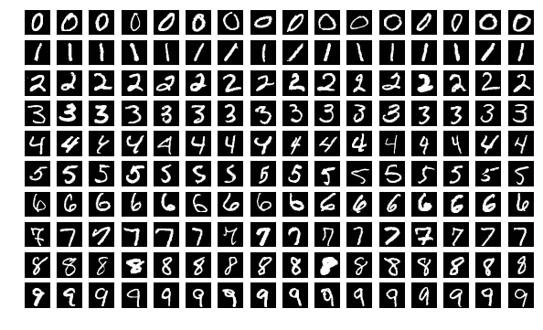
Future Work
There are a lot of characters that are so similar that even humans face difficulty recognizing them and thus CNN is predicting them wrong Such as ‘b’ and ‘6’
‘b’ ‘6’
The proposed method can be extended to quadratic equations by employing
the same technique of segmentation and recognition.
The dataset can be expanded to include the remaining alphabets, thus increasing the domain of the system.

Slide 17
References
S. Shinde, R. B. Waghulade, D. S. Bormane, A new neural network based algorithm for identifying handwritten mathematical equations, International Conference on Trends in Electronics and Informatics ICEI, 2017.
S. Shinde, R. B. Waghulade, An Improved Algorithm for Recognizing Mathematical Equations by Using Machine Learning Approach and Hybrid Feature Extraction Technique, International Conference on Electrical, Instrumentation and Communication Engineering (ICEICE2017), 2017.
I. Ramadhan, B. Purnama, S. A. Faraby, Convolutional Neural Networks Applied to Handwritten Mathematical Symbols Classiﬁcation, Fourth International Conference on Information and Communication Technologies (ICoICT), 2016.
G. S. Tran, C. K. Huynh, T. S. Le, T. P. Phan, Handwritten Mathematical Expression Recognition Using Convolutional Neural Network, 3rd International Conference on Control, Robotics and Cybernetics (CRC), 2018.
L. D’ Souza, M. Mascarenhas, Offline Handwritten Mathematical Expression Recognition using Convolutional Neural Network, International Conference on Information, Communication, Engineering and Technology (ICICET), Zeal College of Engineering and Research, Narhe, Pune, India, 2018.
Y. Hu, L. Peng, Y. Tang, On-line Handwritten Mathematical Expression Recognition Method based on Statistical and Semantic Analysis, 11th IAPR International Workshop on Document Analysis Systems, 2014.
M. B. Hossain, F. Naznin, Y. A. Joarder, M. Z. Islam, M. J. Uddin, Recognition and Solution for Handwritten Equation Using Convolutional Neural Network, Joint 7th International Conference on Informatics, Electronics & Vision (ICIEV), 2018.
A. D. Le, M. Nakagawa, Training an End-to-End System for Handwritten Mathematical Expression Recognition by Generated Patterns, 14th IAPR International Conference on Document Analysis and Recognition, 2017.
G. Cohen, S. Afshar, J. Tapson, & A. van Schaik, EMNIST: an extension of MNIST to handwritten letters, 2017 [Online]. Available: http://arxiv.org/abs/1702.05373 [Accessed Aug. 08, 2019].

Slide 18
Thank You

